Slide 1

Credit Card Fraud Detection, Default Prediction and Approval Prediction Using Stacked Ensemble Technique
Data Mining and Machine Learning 1
Abhinav Thapa – 20259409
M.S. in Data Analytics, Group B

Slide 2

Introduction
Credit card usage is susceptible to frauds, defaults and misuse.
Advanced ML technologies employed for
Approval of Credit Card applications
Predicting Defaulting Clients
Detecting Fraudulent transactions from the regular.
Stacked Ensemble Learning Technique utilizes multiple base-learners for classification and 1 meta-learner for selecting best model out of base-learners.

Slide 3

Research Question
As a part of this project, the objective is to determine whether the accuracy of credit card approval prediction, credit default prediction and fraud detection be improved using Stacking of supervised machine learning models, compare Stacked models and find the best performing model among them.

Slide 4

Datasets
Credit Card Approval Prediction Dataset
Credit Default Prediction Dataset
Credit Card Fraud Detection Data

Slide 5

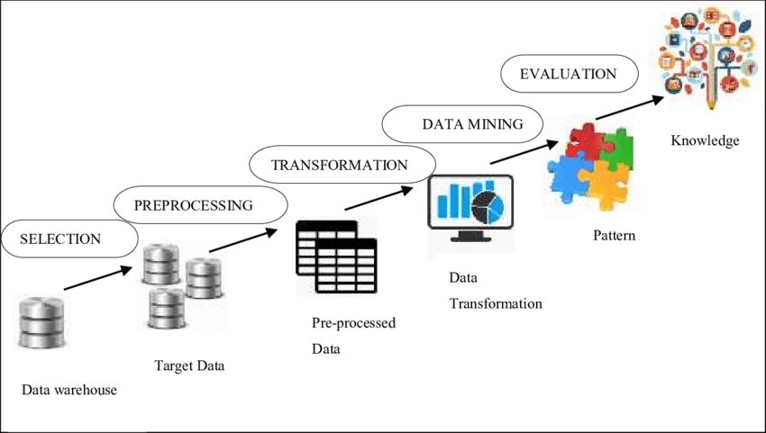


Methodology

Slide 6

Code Review: Credit Approval

Slide 7
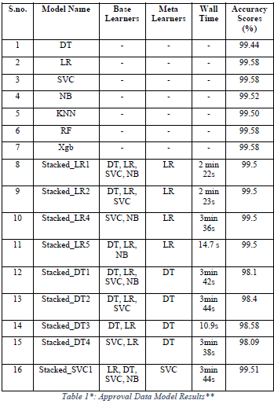

Results: Credit Approval Prediction

Slide 8

Code Review: Credit Default

Slide 9
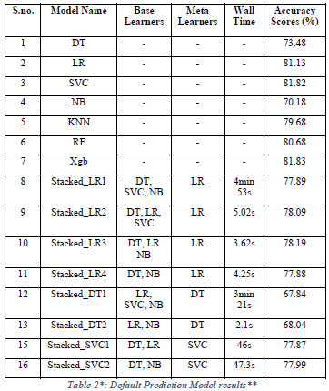
Results: Credit Default Prediction

Slide 10

Code Review: Credit Card Fraud

Slide 11
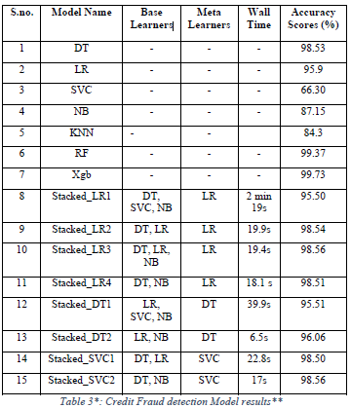
Results: Credit Fraud Detection

Slide 12
Conclusion
To conclude this project, we identified and carried out a series of analyses on a collection of datasets using Python and evaluated the Stacked Ensemble Learning Models.
Stacked Ensemble Learning is the right approach when the necessity for peak performance is essential no matter the complexity and computational effort, however, such algorithms are highly dependent upon dataset size and complexity. While increasing complexity can improve performance, it is not certain with SVC and KNN algorithms that use spatial metrics for prediction. We also observed that SVC and KNN are not preferably suitable for large datasets and complex ensemble techniques as they become very computationally expensive for each increased quantity of base learner.
Our in-depth analysis, only halted by computational capacity, completed the research with the inference that Stacked Ensemble Techniques can improve the accuracy of the models compared to other techniques, however, careful evaluation and model selection will help in reducing complexity and, increasing speed and feasibility.

Slide 13


